Slide 1
ORAL ANTİKOAGULAN İLAÇ KULLANAN HASTALARIN TEDAVİYE UYUMLARININ VE KANAMA HİKAYELERİNİN DEĞERLENDİRİLMESİ
ASSESMENT OF MEDICATİON ADHERENCE AND BLEEDING COMPLICATIONS IN PATIENTS RECEİVİNG ORAL ANTICOAGULANTS
Stj. Dr. İrem Basmacı
Mentor: Prof. Dr. Ramazan Ozdemir (Department of Cardiology)

Slide 2
Introduction
Oral anticoagulant drugs are common used drugs in cardiology clinics to prevent thromboembolism.
New Oral Anticoagulants
rivaroxaban
apixaban
edoxaban
dabigatran
Vitamin K Antagonists
warfarin
VKAs have been used for a long time but they have several limitations such as drug interactions, narrow therapeutic window, drug-food interactions, need for close INR (international normalized ratio) measurements.
NOACs (Novel oral anticoagulants) are shown to be non-inferior to warfarin in the prevention of thromboembolism and even have better safety profile.

Slide 3
Most common and very important side effect of oral anticogulant drugs is bleeding. The bleeding can be major or minor. Major bleedings can be mortal.
Major bleedings: intracranial, retroperitoneal, massive gastrointestinal bleedings and bleed with hemodynamic instability.
Minor bleedings: epistaxis, uncomplicated soft tissue, superficial skin bleedings.
The aim of our study is to assess patient’s anticoagulant drug treatment adherences, level of the knowledges about their drugs and their drug induced bleeding histories.

Slide 4
material-method
Patients recruited for this study were randomly selected from the list of patients using oral anticoagulants with cardiologic endication in Bezmialem Hospital Cardiology Clinic.
Anticoagulation therapy adherence and knowledge levels was assessed using the 6-item Modified Morisky Medication Adherence Scale (MMAS) .
Patient demographics and some informations about their medical history were evaluated.

Slide 5
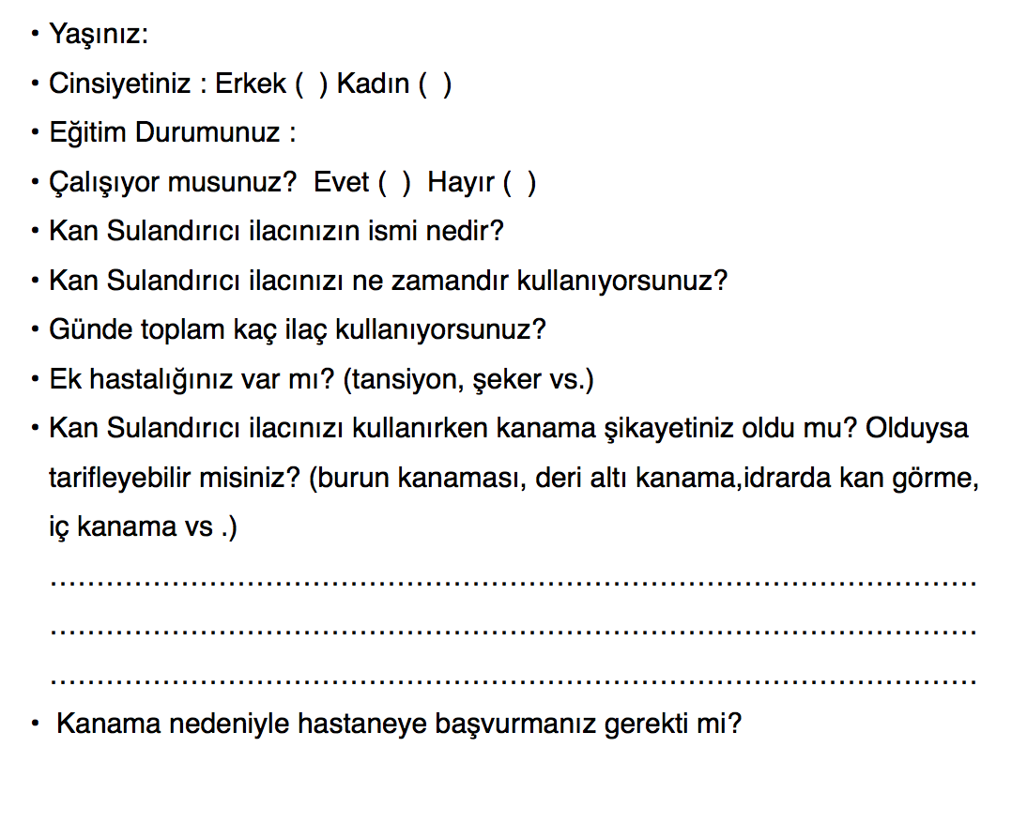
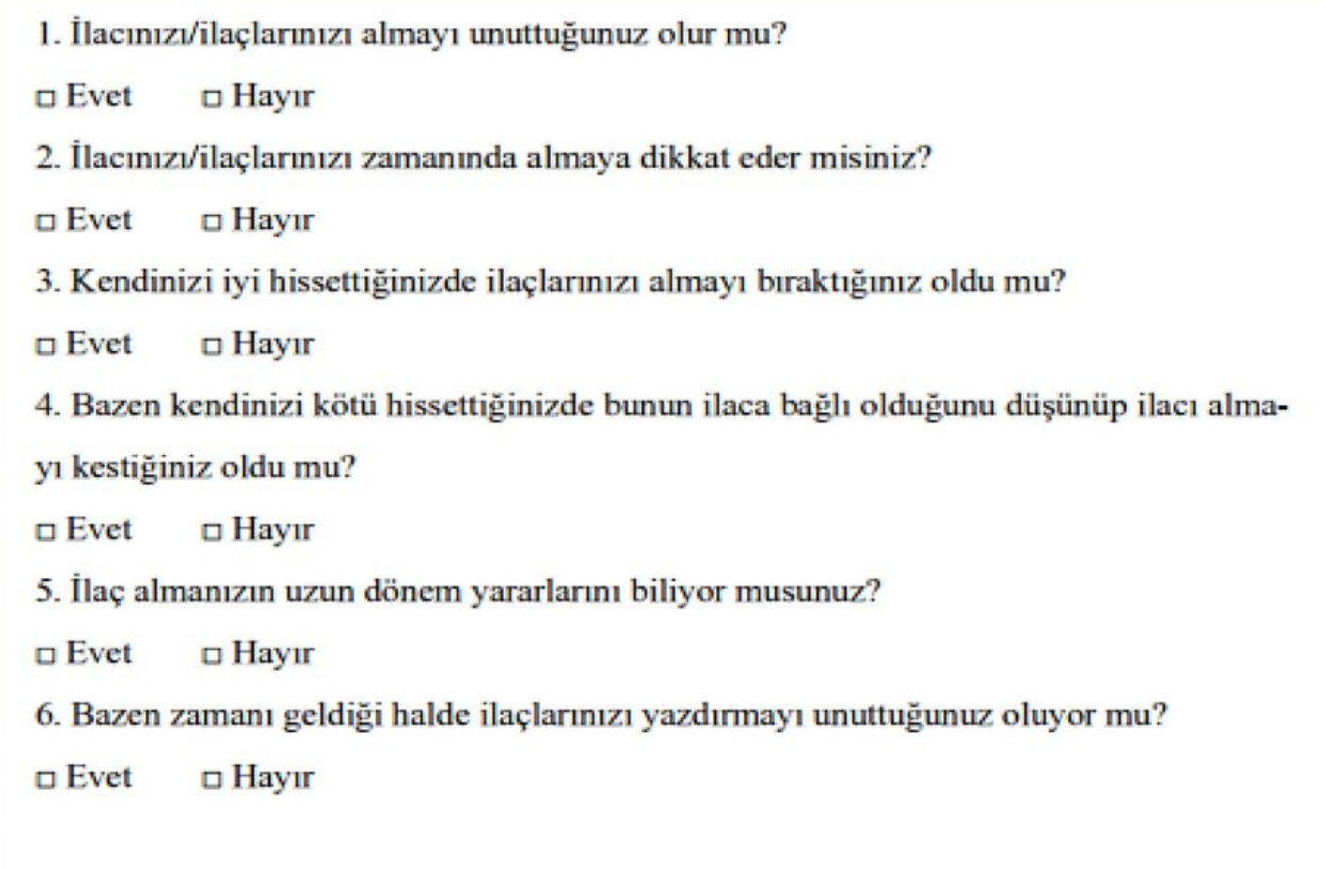
survey

Slide 6
High Adherence:
ilacımı almayı unutmam +1
ilacımı her gün zamanında alırım +1
ilacımı yazdırmayı unutmam +1
High Knowledge:
kendimi iyi hissettiğimde ilacı bırakmam. +1
kendimi kötü hissettiğimde ilaca bağlı olduğunu düşünmem. +1
ilacı neden kullandığımı biliyorum. +1

Slide 7
135 patients completed the survey.
(VKA: 68, NOAC: 67)
Age:
Mean age of 135 patients included in the study was 66,51.
Gender:
Of all patients 34% of male.
Education:
88% of all patients under the ‘high school’ education degree.
Other drugs:
46 %of all patients use 3+ drugs.
73%of all patients have comorbidities. (hypertension, diabetes, obesity, heart and kidney diseases etc.)

Slide 8
Among the patients,
86% showed high adherence to medication with MMAS-8 score,
116 patient
102 patient
76% showed high knowledge levels with MMAS-8 score.

Slide 9
30% of the patients had history of minor bleeding (gum, nose and subcutaneous bleeding) while using anticoagulants, 5% of the patients had history of major bleeding.
There is no relationship between adherence and knowledge levels and bleeding histories of patients. (p>0.05)

Slide 10
all the patients who are upper high school levels have high knowledge levels and high adherence.
There is significant relationship between adherence and knowledge levels and education levels of patients. (p<0.05)

Slide 11
Conclusion:
As we have seen in our study, the majority of patients taking oral anticoagulants had high adherence and knowledge levels. They were satisfied with their anticoagulation therapy.

Slide 12
Assesment Of Medication Adherence And Bleeding Complications In Patients
Receiving Oral Anticoagulants
İrem Basmacı¹, Ramazan Özdemir²
1Bezmialem Vakıf University Faculty Of Medicine, Istanbul, Turkey
2Bezmialem Vakıf University Faculty Of Medicine, Department Of Cardiology, Istanbul, Turkey
Introduction: Oral anticoagulants (VKAs and NOACs) are common used drugs in cardiology clinics. Most common side effect of anticogulants is bleeding. The aim of this study is to assess patient’s anticoagulant drug treatment adherence, level of the knowledge and drug induced bleeding history.
Method: Patients recruited for this study were randomly selected from the list of patients using oral anticoagulants with cardiologic endication in Bezmialem Hospital Cardiology Clinic. Anticoagulation therapy adherence andknowledge levels was assessed using the 6-item Modified Morisky Medication Adherence Scale (MMAS) . Patient demographics and some informations about medical history were evaluated.
Results: 135 patients completed the survey: 50% were on VKAs and 50% on NOACs. Mean age of 135 patients included in the study was 66,51. Of all patients 34% of male. Among the patients, 86% showed high adherence to medication MMAS-8 score, 66% showed high knowledge levels. 30% of the patients had history of minor bleeding (gum, nose and subcutaneous bleeding) while using anticoagulants, 5% of the patients had history of major bleeding. No significiant difference was found between treatment adherence, knowledge levels and bleeding histories in VKA or NOAC users (p>0.05). Knowledge of bleeding risks was lower in patients older than 70 and patients with low education degrees.
Conclusion: As we have seen in our study, the majority of patients taking oral anticoagulants had high adherence and knowledge levels. They were satisfied with their anticoagulation therapy.
Key Words: oral anticoagulant therapy, bleeding, drug adherence.

Slide 13
thank you for listening

